Slide 1
Line Rejection Data
-Sarah Brown-

Slide 2
What is affecting Line Rejection?

Slide 3
Factory and Line Rejection Rate

Slide 4
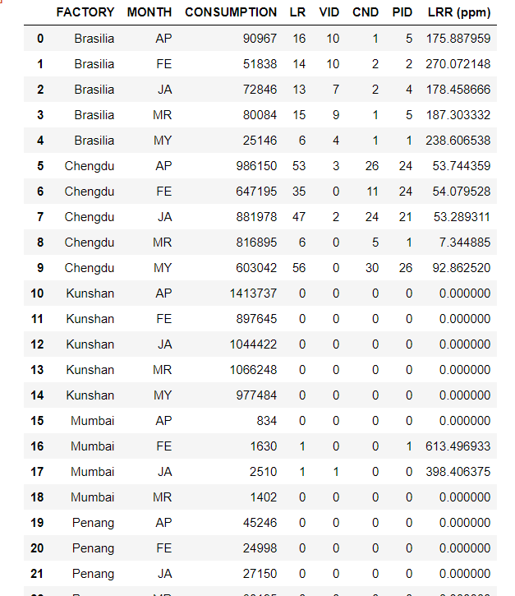
Data Cleaning Factory and LRR

Slide 5
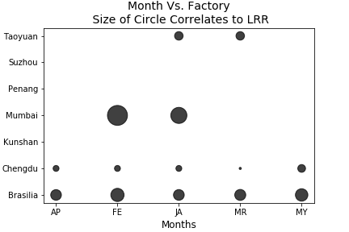

Slide 6
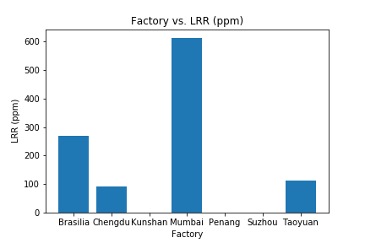
Factory Vs LRR

Slide 7

Supplier Vs Line Rejection Rate

Slide 8
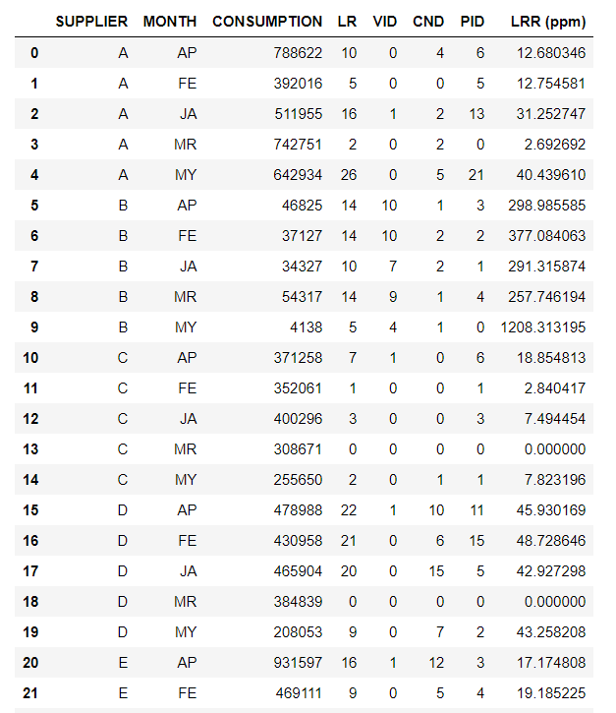
Data Cleaning for LRR vs Supplier

Slide 9
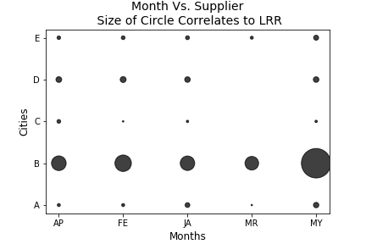

Slide 10
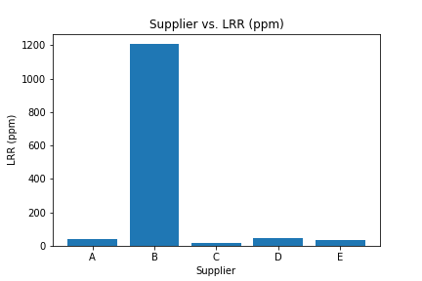
Supplier vs LRR

Slide 11
Does the average temperature affect the Line Rejection Rate?

Slide 12
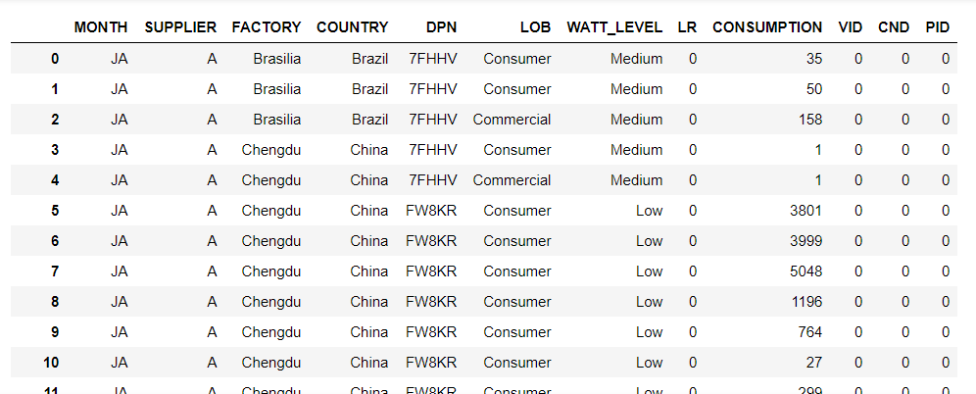
Cleaning data.

Slide 13
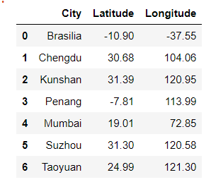
openweatherAPI

Slide 14
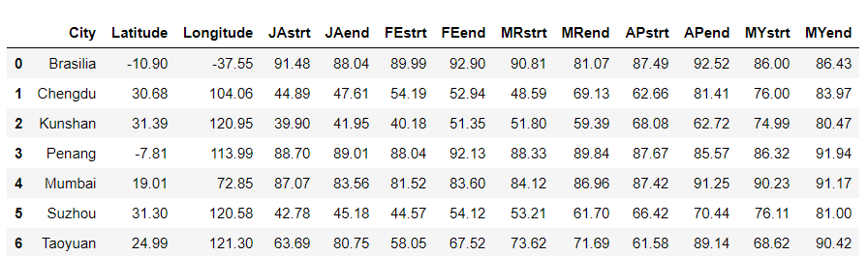
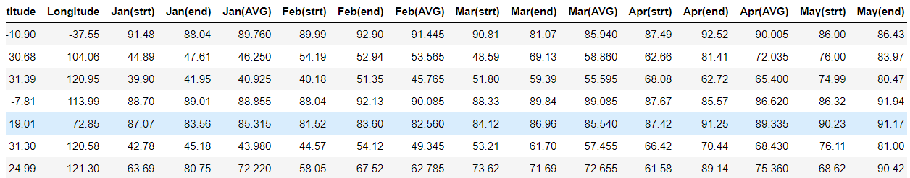
Dark Sky API before and after.

Slide 15
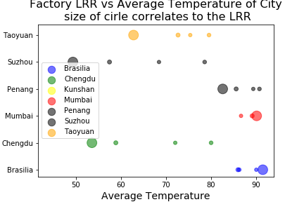

Slide 16
Conclusions:
LRR and supplier and factor
Supplier B had the highest LRR
Mumbai Factory had the highest LRR
Weather was not affecting the LRR

Slide 17
Resources for API
https://openweathermap.org/
https://api.darksky.net/forecast/

